Slide 1
Hampshire Learning Disability Partnership Working Groups Terms of Reference (draft)
January 2022

Slide 2
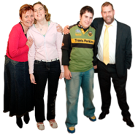
How the groups fit together
Hampshire Learning Disability Partnership
Carers Partnership Board
Least Restrictive Practice Forum
Staying Safe Being Safe
Complex Needs
Adult Social Care
Health & Wellbeing
Communication
Carers
Day Services
Social Groups
Lunch clubs
Launchpads
Self Advocacy groups
Support Groups
Provider forums

Slide 3
Adult Social Care
What should it talk about?
Making social care better for people with a learning disability in Hampshire (How we do social work)
How can Hampshire County Council improve how it supports people with a learning disability (the services it buys; its own respite services and day services; how the Council and Hampshire can be more accessible for people with a learning disability)
Other topics related to adult social care
How often does it meet?
Monthly
Who can be a member?
8 self-advocates
HCC representative + officer to facilitate
Health representative (CCG or SHFT?)
Provider rep (tbc)
Where does it meet?
tbc
Possible ideas to talk about in 2022
Video / easy-read to help people to understand how to access services
Automated reviews roll-out
Increase diversity amongst self-advocates ?

Slide 4
Health & Wellbeing
What should it talk about?
How to live a healthy life (inc. healthy eating, hygiene, dental care etc)
How can health services be more welcoming to people with a learning disability (primary care, hospitals, GPs, dentists, health screening, opticians etc)
Wellbeing, Mental Health & Physical Health
Other topics related to health and wellbeing / health services
How often does it meet?
Monthly
Who can be a member?
8 self-advocates
SHFT representative
CCG representative
Public Health representative
HCC representative + officer to facilitate
Provider rep (tbc)
Where does it meet?
tbc
Possible ideas to talk about in 2022
LD annual health checks
Vaccinations
Healthy eating
Cancer screening
Sexual Health awareness

Slide 5
Communications
What should it talk about?
How people with a learning disability want to access information
How it can support people / organisations to make their information accessible for people with a learning disability
How people can access technology
How often does it meet?
Monthly
Who can be a member?
6 self-advocates
2 parent/carers
HCC officer to facilitate
Where does it meet?
tbc
Possible ideas to talk about in 2022
Website development and launch
Newsletters
Increasing participation amongst people with a learning disability

Slide 6
Staying Safe Being Safe
What should it talk about?
What people can do to help keep themselves safe
How organisations like the police, fire service, citizen’s advice etc can make themselves accessible to people with a learning disability
Hate Crime / Mate Crime
Scams (online, postal etc)
How often does it meet?
Monthly
Who can be a member?
6 self-advocates
Police representative
Fire Service representative
Trading Standards representative ?
Citizen’s Advice representative ?
Argenti (TEC) representative
HCC officer to facilitate
Where does it meet?
TBC
Possible ideas to talk about in 2022
Review of Safer Places scheme
Gather directory of resources that can be shared on the new website
Organising a community safety day (to run annually)

Slide 7
Carers (LD)
What should it talk about?
This group is a sub-group of (reports into) both the Hampshire Learning Disability Partnership and the Hampshire Carers’ Board
Issues specific to carers of someone with a learning disability
More generic issues affecting carers
Issues that the carers want to be considered by either / both the Hampshire Learning Disability Partnership and the Hampshire Carers’ Board
How often does it meet?
Monthly
Who can be a member?
8+ carers
Representatives from Carers’ organisations (PRTC, Carers’ Together, Andover Mind, HPCN)
Representative from HCC
Where does it meet?
tbc
Possible ideas to talk about in 2022
Automated reviews implementation
Market Position Statement

Slide 8
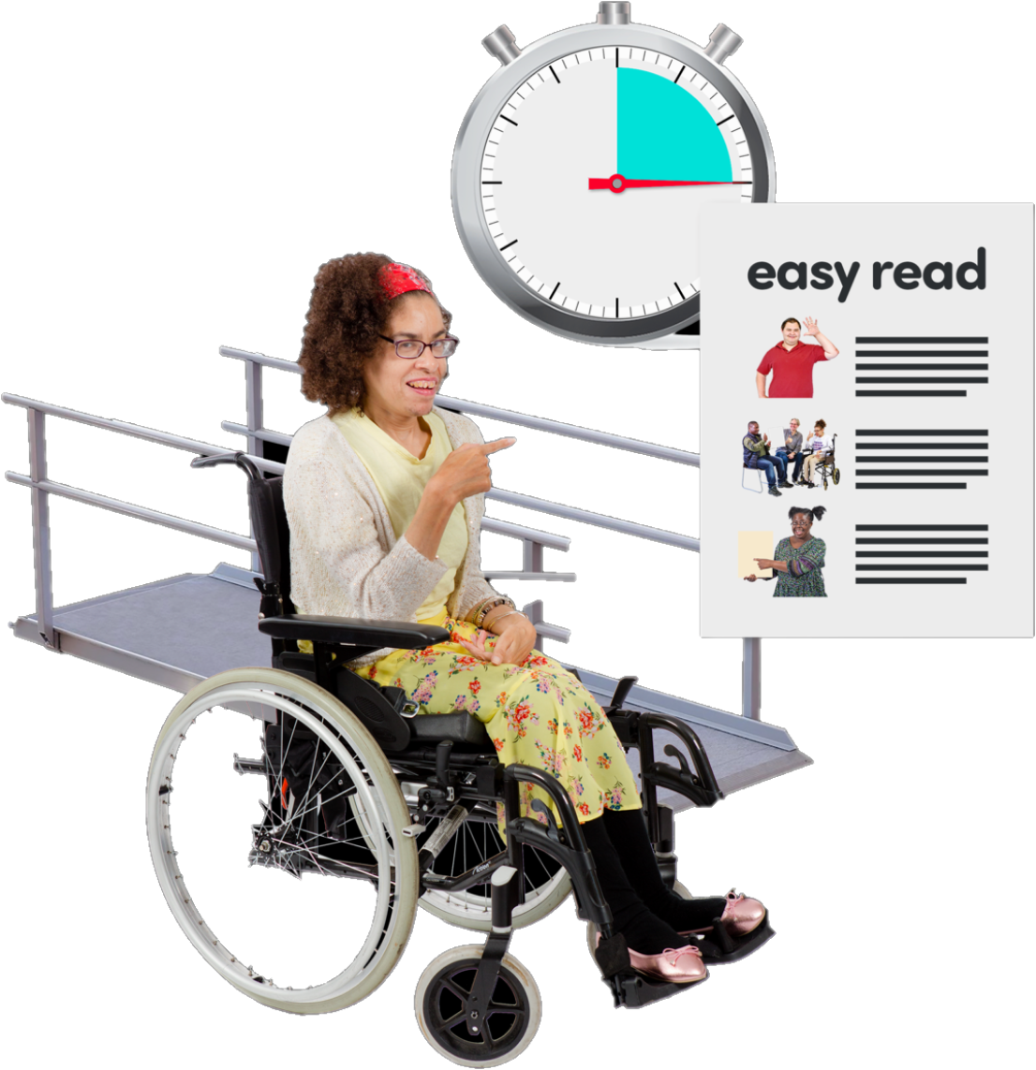
Complex Needs
What should it talk about?
Issues that affect people with more complex needs who cannot express themselves, even with advocacy support.
Development of sustainable services for people with complex needs in Hampshire
How often does it meet?
Monthly
Who can be a member?
6 parent / carers
4 representatives of providers supporting people with complex needs
HCC representative + officer to facilitate
Health representatives (CCG and/or SHFT)
Where does it meet?
tbc
Possible ideas to talk about in 2022
Improvements to services for people with profound and multiple learning disabilities
Supporting market development / embedding Least Restrictive Practice
Supporting the development of the Trauma Informed Care Offer

